Slide 1

Baymax
Group No. 24
Rupesh Prasad. – 14104010
Nikhil Sonawane. – 16204010
Rajesh Kumar Soni. - 16104063
Mr. Kiran Deshpande and Mrs.Apeksha Mohite

Slide 2
Abstract
Artificial intelligence (AI) technologies and techniques have useful purposes in every domain of mental health care including clinical decision-making, treatments, assessment, self-care, mental health care management and more. Recent technological innovations are highlighted to demonstrate capabilities and opportunities. This project involves an AI based Expert System which can significantly contribute to improving mental health of an individual to lead a better life without any stress or melancholy. The expert system provides expert advice and therapy to overcome negative thoughts. This project can also help to reduce the number of suicides caused due to extreme depression.
This project is about virtual human conversation with the system to support user’s interaction within a mental health care context. It provides private online healthcare guidance and support where the app can serve the role of a clinician or a psychotherapist.

Slide 3
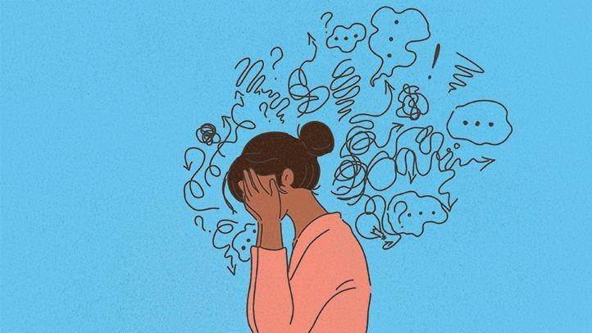
Introduction
As per a survey by WHO in 2020, close to 800,000 people die due to suicide every year and there are many more who attempt suicide.
Suicide occurs throughout the lifespan and is the second leading cause of death among 15-29 year olds globally
An application in your mobile phone that can handle whatever life throws at you and helps you live the best life you can.
We need an application which will help people to deal with depression, anxiety, social distress, relationship stress, career stress, body image, loneliness.
Various technologies like Artificial Intelligence, Expert System, Fuzzy Logic can be used in making such an application.

Slide 4
Objective
The concept behind developing this android application is the detection of depression in an individual and giving them an online help to prevent it or to find a cure for their depression.
The aim of our project is to develop a user friendly android application which enhances better graphical user interface that will help a user to interact in a proper way which will help us to examine their problem.
The scope of the project in near future is just to help the user an individual suffering or going through depression to lure him out of it.

Slide 5
Literature Review
Paper Title : Releasing Stress Using Music Mood Application: DeMuse
Authors: Aslina Baharum1, Tan Wei Seong1, Nurul Hidayah Mat Zain2, Nurhafizah
Moziyana Mohd Yusop3, Muhammad Omar4, Nordaliela Mohd. Rusli
Publication details : Universiti Malaysia Sabah, 88400 Kota Kinabalu, Sabah, Malaysia 2017
Findings: A content-based analysis was conducted in order to obtain the features that are valuable enough as the properties usage in the development of prototype. In this content analysis, a number of Music, which are “Relax Lite: Stress Relief”, “Calm”, “Relax & Rest Guided Meditations”, “MindShift”, and “Pacifica: Stress & Anxiety”.
Advantages: Stress free Music
Disadvantages: Chatbot was not provided and Fuzzy Logic was not provided only music
was Introduced

Slide 6
Literature Review
Paper Title : Comparison of read and spontaneous speech in case of Automatic Detection of Depression
Authors: Gábor Kiss, Klára Vicsi
Publication details : Department of Telecommunications and Media Informatics Budapest University of Technology and Economics Budapest, Hungary, 2017
Findings: Speech samples were collected from healthy and depressed subjects in quiet environment with head microphone. The recordings were recorded at 44,1 kHz with 16-bit sample rate. Two types of speech sample were recorded from each subject, read speech: a short folk tale “The North Wind and the Sun” and spontaneous speech: dialogue between the examined subject and interviewer, both in Hungarian language. A total of 73 subjects were recorded, 42 females and 31 males. From the 73 subject 48 subjects were diagnosed with depression, 30 females and 18 males, and 25 subjects were healthy, 12 females and 13 males
Advantages: Psychological Status Monitoring by G. Kiss, K. Vicsi • Comparison of read and spontaneous speech in case of Automatic Detection of Depression Computerized Analysis of Language phenomena (COALA) (AO-11-Concordia).
Disadvantages: Chatbot was not provided and Fuzzy Logic was not provided

Slide 7
Literature Review
Paper Title : Workplace Stress Detection Approaches
Authors: Sami Elzeiny, Marwa Qaraqe
Publication details : College of Science and Engineering Hamad Bin Khalifa University Doha,
Qatar
Findings: Define the main goal and strategy of the organization.Construct a clear leadership structure and hierarchy.Limit working shifts to 12 hours maximum with overlapbetween shift to ensure briefing the following staff.Provide training, communication tools such as phones,intranet portals.Rotate employees between high-, mid-, low-stress tasks,and encourage breaks and vacations.Consider flexible working scheme including part time job,distance working, or sharing job
Advantages: Electrocardiography (ECG),Electroencephalography (EEG),Electrodermal activity(EDA).
Galvanic Skin Response Disadvantages: Chatbot was not provided and Fuzzy Logic was
not provided, for only office people.

Slide 8
Literature Review
Paper Title : Machine Learning Techniques for Stress Prediction in Working Employees
Authors: ADITYA VIVEK THOTA, A DHARUN
Publication details : SRINIVASULU REDDY Assistant Professor, Machine Learning and Data Analytics Lab, Department of Computer Applications, National Institute of Technology, Trichy
Findings: This is highly effective in healthcare as there is enormous amount of data and if this is properly fed to an intelligent system and trained accordingly, the resulting prediction model will be unparalleled and free from human errors and reduce the time required for diagnostics. Hence, the responses of the OSMI 2017 dataset were used to train the following ML models that are previously tested in healthcare based classification problems
Advantages: Motivational thoughts according to there requirements.
Galvanic Skin Response Disadvantages: Chatbot was not provided and Fuzzy Logic was
not provided, for only office people.

Slide 9
Literature Review
Paper Title : Distributed Grating Sensor Stress Data Acquisition and Management System
Authors: Zhenhai Mu , Lizhen Jiang
Publication details : Guilin University of Aerospace Technology ,Guilin,541004,China
Findings: As a popular measuring tool, grating sensor should be used.The range of application is more and more extensive. The advantages of high-precision data measured make it a promising development prospect at home and abroad. At the same time, the system design of this subject needs to combine hardware and software.
Advantages: Detect The level of stress
Galvanic Skin Response Disadvantages: Chatbot was not provided and Fuzzy Logic was not provided, Only level is shown.

Slide 10
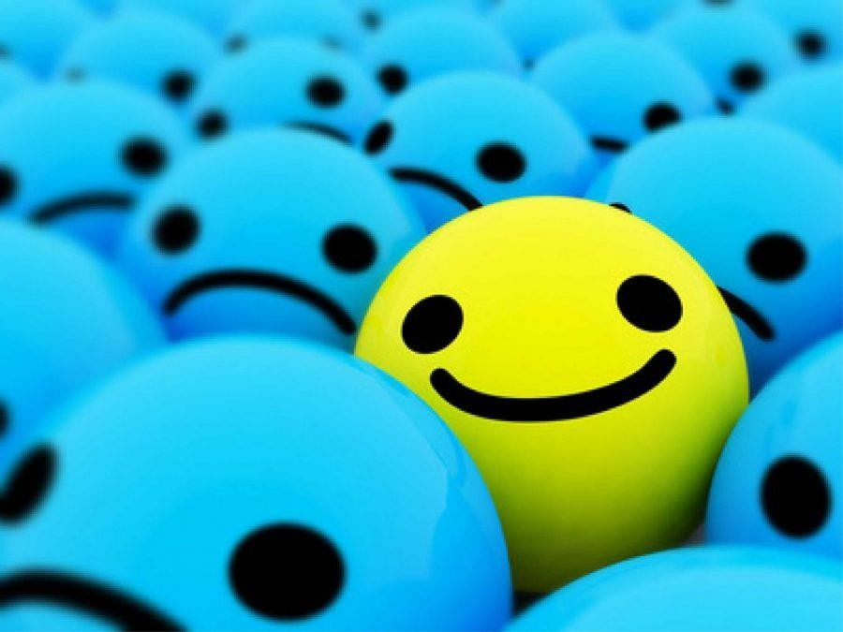
Problem Definition
Baymax is an AI based application, which serves as a companion and is capable of understanding people’s emotions.
It helps to deal with depression and stress by guiding the person to think rationally and deal with any situation in an optimistic manner.
Baymax is capable of analyzing depression levels and provides psychotherapy.
The Baymax software must take care of all the cases that will be encountered during conversation.

Slide 11
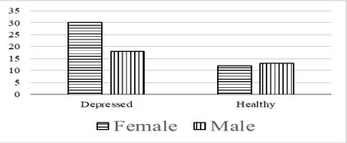
Existing System Architecture/Working
Comparison of read and spontaneous speech in case of Automatic Detection of Depression (2017)
Speech samples were collected from healthy and depressed subjects in quiet environment with head microphone. The recordings were recorded at 44,1 kHz with 16- bit sample rate. Two types of speech sample were recorded from each subject, read speech: a short folk tale “The North Wind and the Sun” and spontaneous speech: dialogue between the examined subject and interviewer, both in Hungarian language.

Slide 12
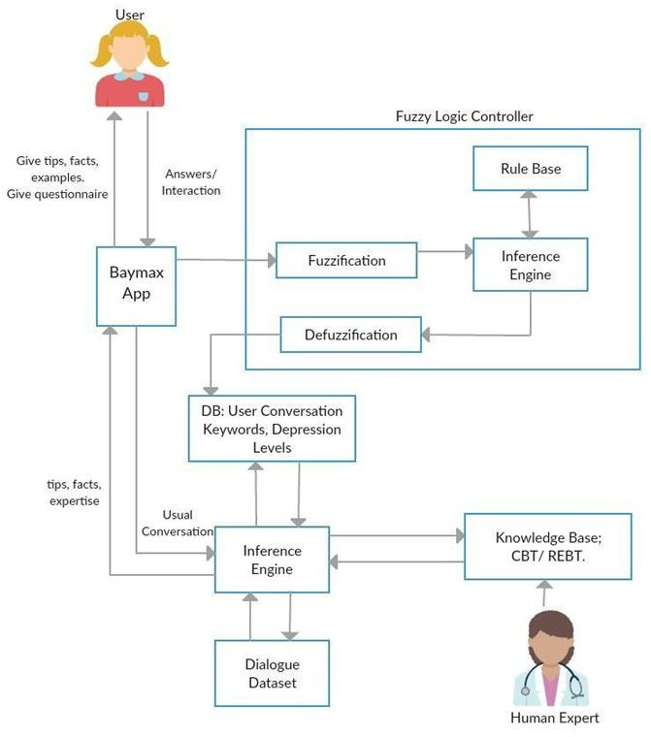
Proposed System Architecture/Working

Slide 13
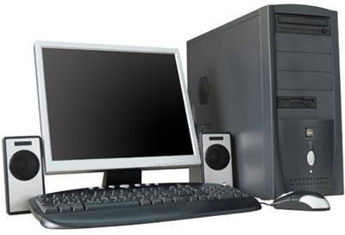
Technological Stack
Hardware
Working Computer with 500GB
Hard Drive and 4GB RAM
Keyboard, Mouse
Software
Kotlin: Using Android studio.
Server-side language (i.e. Firebase) to control/handle requests from your Android application.
Rule Engine: DROOLS.

Slide 14

Technological Stack
We are going to develop an android app which can be done in Android Studio.
The Android Studio is freely available and is based
kotlin programming language.
The app is based on Artificial Intelligence and implements an expert system.
The Rule base will be implemented using Drools Rule Engine.

Slide 15
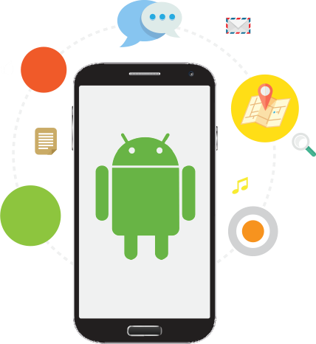
Technological Stack
The user has to install the app and then enter his name and age. No other registration process is required.
The user has to answer the questionnaire so that his depression level can be measured.
The user has to chat with Baymax so that his thoughts, feelings could be identified.
The toolkit consists of positive thoughts to overcome the illness, motivational examples, meditation tips, yoga tips, physical exercises that have proven to reduce stress.
It also consists of a spiritual section which will include certain chants and mantras that bring positive vibes.

Slide 16
Future Scope
The aim at detecting the depression level of a certain age criteria. From the result, it can be clearly stated that people differ from the state of health to do so the person's information is kept in database and each individual is provided with a different level of treatment.
Given the current versatility and variety of development option for mobile application, the key is to determine what platform will best align with your business problems and goals. Mobile application are a powerful tool for connecting with the consumer, businesses and users, and their functionality and value is only increasing as the world continues to more towards mobility.
As the features where compared with some other significance features, and as a result it was stated that few project where dealing only till the depression detection. As this application deals with the detection as well as to help to decreased the level of depression.
This application should immediately send an alert to the user’s acquaintance when it identifies that the user is going to take a fatal decision.

Slide 17
Refrences
Sami Elzeiny, Marwa Qaraqe(Blueprint to Workplace Stress Detection Approaches) 2018.
Comparison of read and spontaneous speech in case of Automatic Detection of Depression(Gábor
Kiss, Klára Vicsi) 2017.
Aslina Baharum1, Tan Wei Seong1, Nurul Hidayah Mat Zain2, Nurhafizah Moziyana Mohd Yusop3, Muhammad Omar4, Nordaliela Mohd. Rusli (Releasing Stress Using Music Mood Application: DeMuse) 2017.
ADITYA VIVEK THOTA, A DHARUN (Machine Learning Techniques for Stress Prediction in Working
Employees ) 2018
Zhenhai Mu , Lizhen Jiang (Distributed Grating Sensor Stress Data Acquisition and Management System )2019

